Slide 1


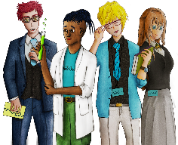











Social Media and Online Stress
Copy
title
Knowledge, Skills & Actions
How is social media made to be addictive?
3 Minutes
Play video
To explore the link between mental health and social media usage
To identify coping strategies to manage online stress
Recognise that social media sometimes does not reflect real life
3 Minutes
What causes you to get stressed?
What do you do to de-stress?
Can social media usage cause you stress?
New Vocabulary
online, social media, post, followers, social currency, online harassment , settings, privacy, cyber bullying
Tasks
Notes:
TEACHER NOTES & IDEAS
Remind students of the learning journey (What theme you are doing – Possibly recap what they can remember from last lesson.
ATTRIBUTION AND COPYRIGHT
– All icons and logos for Cre8tive Curriculum are created Inhouse by Michael Gillman ©
All images are sourced correctly – mainly through the following sites
either Premium licence at https://www.freepik.com/ or www.Pixabay.com or https://www.pixelscrapper.com/help
Some image have purchased also.
Factual information is not copyrighted.
Where information has been taken from reliable 3rd party websites – it is done so for analytical purposes in small pieces of text and for educational purposes.
Always check the content of any lesson and videos linked before teaching to ensure suitability for your classroom and your school
Further Terms and Condition regarding Copyright and our terms of use can be found on our website here https://cre8tiveresources.com/terms-of-use/

Slide 2
























REFERENCE SLIDE
Teamwork
New Vocab
Discussion task
Play video
NEW
VOCABULARY
DISCUSSION TASK
THE LAW
EXPLAINED
TEAMWORK TASK
PROJECT
WORK
PLAY
VIDEO
Thoughts
Research
Extension
task
Tasks
Problem
solving
TASKS
EXTENSION
TASK
THOUGHTS
FURTHER RESEARCH
HOMEWORK
PROBLEM SOLVING
Feelings
Copy
information
Revision
Design Task
ASSESSMENT OPPORTUNITY
FEELINGS
REVISION
TASK
DESIGN
TASK
COPY INFORMATION
SENSITIVE ISSUE
WARNING
Notes:
TEACHER NOTES & IDEAS
This is a teacher reference slide - Icons will be used throughout Cre8tive Curriculum lessons to denote what students can do.
Could be printed and laminated on A3 and stuck up in the classroom

Slide 3


PSHE
Show respect
By listening
Not interrupting
Only 1 person talking at a time
Be open and honest but no personal comments – Discussions will be about ‘general situations’
Don’t make assumptions about people’s values, attitudes, behaviours, life experiences or feelings
PSHE CLASSROOM RULES
DEALING WITH SENSITIVE TOPICS
SAFEGUARDING YOUR WELFARE & HAVING YOUR INTERESTS AT HEART
You don’t have to say things about yourself if you don’t want to (You have the right to pass)
There are no stupid questions. A question box for anonymous Questions
It’s OK to get things wrong
Have a non-judgemental approach. No put downs and challenge the opinion not the person
Enjoy the lesson, Challenge your perceptions and understand how to seek further advice and support
Use the agreed appropriate Language (Avoid slang terms)
Conversations stay in the room unless it is a safeguarding issue
Don’t show the fact you are embarrassed through silliness
Notes:
TEACHER NOTES & IDEAS
Reinforce ground rules at the start of every new topic / new term
Adapt this set of rules to suit your classroom and your teaching.
Display your agreed PSHE classroom rules in a prominent place so students have a constant reminder and when/if a student breaks a rule you can use as a prompt to get them back on track.
If behavior is an issue revisit the ground rules – Use raffle tickets , positive behavior management (look for the good behavior)
Reward the behavior you want to see, be consistent and fair with students.
Create a classroom charter with the students (optional)

Slide 4














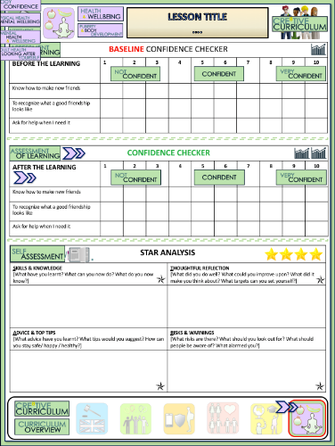






Social media and online stress
BASELINE CONFIDENCE CHECKER
BEFORE THE LEARNING | 1 | 2 | 3 | 4 | 5 | 6 | 7 | 8 | 9 | 10
I can explain what online stress is
I understand the link between mental health and social media usage
I know how to keep my online data safe
Complete a baseline assessment of where you think you are at for this lesson
(Discussion or complete sheet)
2 Minutes
I’m not confident at all
I’m getting more confidence
Confident
Very
confident
Super
confident
Notes:
TEACHER NOTES & IDEAS
This could be done by writing a number down in the books
Show of fingers in the air. /Red amber Green Cards
Quick Partner Discussion
Print off the Assessment Opportunity Sheet – Fill in the Baseline Confidence Checker

Slide 5
ROUND 1
NAME THAT SOCIAL MEDIA PLATFORM
A
B
C
….is the 2nd
most popular
social network and the 3rd most famous. … is described by fans as: Addictive, A favourite, Engaging, Colourful and Visually impressive.
the most popular
social network
and the most famous. …. is described by fans as: Addictive, Always check it, Helps me keep in touch, Accessible and A favourite.
… Is very popular
amongst young people but not the older generation … is described by fans as: A favourite, Brilliant, Always check it, Amusing and Colourful.
A: Instagram
B: Facebook
C: Snapchat
D
E
F
….. is described by fans as: Informative, Always check it, Helps me keep in touch, Easy to use and Social. News breaks quickly on this platform.
…. Is Interesting,
Easy to use, A favourite, User friendly and Entertaining. Great for new ideas and making boards
Helps me keep
in touch, Couldn't do without it, Constructive, Informative and Useful. Helps to connect people in a professional way
D: Twitter
E: Pinterest
F: LinkedIn
PINTEREST
INSTAGRAM
SNAPCHAT
TWITTER
FACEBOOK
LINKEDIN
Notes:
A list of licenses for the images used in this presentation can be found here: https://creativecommons.org/licenses/

Slide 6
ROUND 2
MULTIPLE CHOICE – GUESS CORRECT
Which is the most popular online
platform amongst teenagers?
A
YouTube
Instagram
Snapchat
Twitter
YouTube
What % of American teenagers reportedly own or have
access to a smart phone?
B
55%
75%
85%
95%
95%
‘What % of teenagers say that social media
has a mostly positive impact on their life?
C
31%
51%
61%
71%
31%
What % of 14 year old girls in the UK are on social media
for more than three hours a day?
D
10%
40%
60%
85%
40%
Notes:
A list of licenses for the images used in this presentation can be found here: https://creativecommons.org/licenses/

Slide 7



WHAT IS ONLINE STRESS?
How can you deal
with online stress?
2 Minutes
We all use social media and it can be great, but sometimes it can also be quite stressful and we can get that feeling of FOMO
Did you know?
Social media is more addictive than cigarettes and alcohol for young people – FOMO (Fear of missing out)
Play video
Notes:
TEACHER NOTES & IDEAS

Slide 8

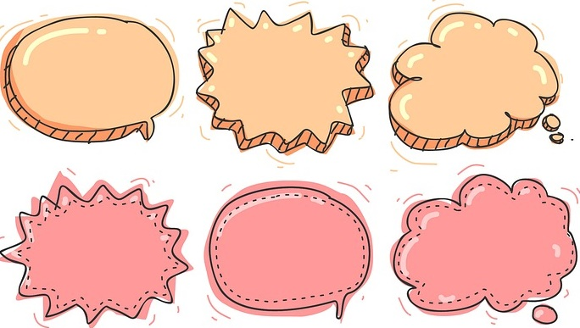
Discussion topics
What makes somebody a good friend in real life?
What do you value most about online friends and followers?
How does social media make its users feel?
What are the benefits and risks of using social media?
Is social media addictive? Why?
Make up a discussion topic

Slide 9
How would you judge yourself to feel about each of the following issues.
Cyber Bullying & Trolls
Addiction to Social Media
How many likes your pics get
Worrying about nasty comments
Not feeling ‘good enough’
How many online friends and Followers you have
Very concerned
Not at all concerned
TASK: If you were Prime Minister what would you do to make people less concerned about some of these issues? Come up with a plan of action

Slide 10


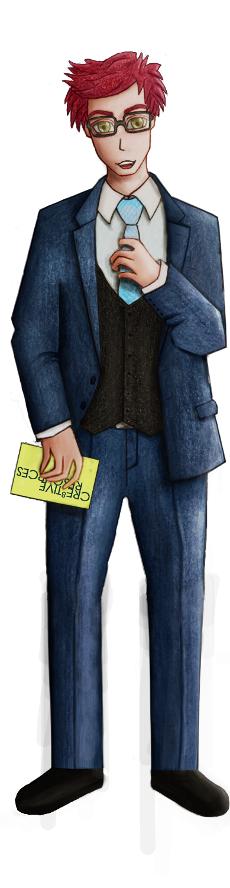





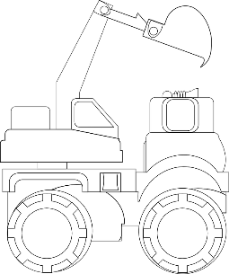
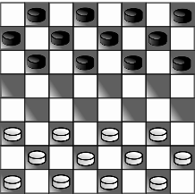

WHAT DO YOU THINK?
“The age limits for using social media sites should increase from 13 to 16”
Talking points
I think that …
I don’t think… is right because…
My opinion is…
I would argue the same because…
I disagree with… because
Building on what ….
An alternate way of looking at this is…
I sort of agree, however….
In my view…
I would challenge what… said because …
?
AGREE
ALTERNATE IDEA
DEVELOP
Disagree
Challenge
Alternative
Idea/option
DISAGREE
Develop
CHALLENGE
Notes:
TEACHER NOTES & IDEAS
Ask students what they think of this image (collection of images)
Reveal the talking points after some discussion time
To provoke discussion with a quiet class – play devils advocate
Challenge a student to a debate

Slide 11
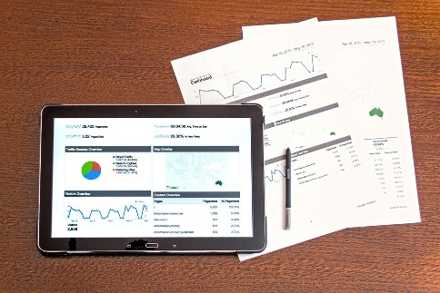
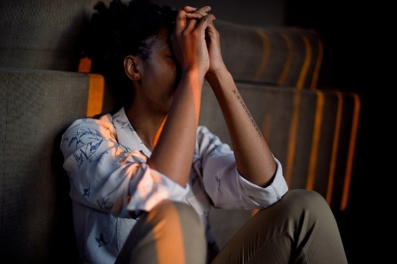

Source: A Report Published in May by the Royal Society who Published a report on Social media and Young Peoples Health
Social media is more addictive than cigarettes and alcohol – FOMO (Fear of missing out)
With females in particular an increase in social media use increases and heightens concerns about their own body image
Increased social media use has a significant link with poor sleep quality and this links with mental health issues
80% of Social media users feel more anxious after using Social media (2+ Hours a day)
70% of users have experienced some form of cyber bullying of which 36% experienced it on a high-frequency basis
57% of 16 to 25 year-olds say that social media creates an “overwhelming pressure to succeed”
46% think that comparing their lives to others on social media makes them feel “inadequate”
48% say they feel “more anxious about their future when seeing the lives of their friends online”
Does anything concern you about this reports findings?
Do you believe all of the findings?
What should be done to tackle some of the issues found in this report?
Problem solving
Notes:
TEACHER NOTES & IDEAS

Slide 12
Optional Activity – Social Media & Mental Health
The four stressors on social media
Highlight Reel
(Only seeing the best parts of peoples lives & comparing ourselves)
Social Currency
(Likes & Followers & Friends)
Fear Of Missing Out - F.O.M.O
(You will not be apart of something everyone else is)
Online Harassment
(Nasty comments, trolling and threats)
How would each of the above impact your mental health?
Which of the above four stressors is the worst?
How can we tackle these?
14 Minutes
Is Social Media hurting your mental health – TEDX Talk
Play video
Notes:
TEACHER NOTES & IDEAS

Slide 13



Social Media & Mental Health
Highlight Reel
(Only seeing the best parts of peoples lives & comparing ourselves)
Social Currency
(Likes & Followers & Friends)
Fear Of Missing Out - F.O.M.O
(You will not be apart of something everyone else is)
Online Harassment
(Nasty comments, trolling and threats)
Post one more time / Lurk one more time
Check likes one more time
Get anxious when we don’t have access
SOCIAL MEDIA USAGE INCREASES – WE NEED IT FOR VALIDATION
Lowers our self esteem
Higher levels of anxiety
Higher levels of depression and suicidal thoughts
Addiction
Notes:
TEACHER NOTES & IDEAS
Canadian Association of Mental Health – 2hours plus a day on Social media

Slide 14
ANAGRAMS –UNSCRAMBLE THE WORDS
Clue: All the words link to online safety
A
T E S T S G I N
SETTINGS
B
R A V E P I T
PRIVATE
C
REPORTING
R O G E R P I N T
D
CONFIDENTIAL
D A N C E T I N F O I L
Notes:
A list of licenses for the images used in this presentation can be found here: https://creativecommons.org/licenses/

Slide 15



Confidence Checker
AFTER THE LEARNING | 1 | 2 | 3 | 4 | 5 | 6 | 7 | 8 | 9 | 10
I can explain what online stress is
I understand the link between mental health and social media usage
I know how to keep my online data safe
Complete the confidence checker of where you think you are at for this lesson (Discussion or complete sheet)
3 Minutes
Notes:
TEACHER NOTES & IDEAS
This could be done by writing a number down in the books – Compare to the start of the lesson
Show of fingers in the air or use Red Amber Green Cards
Quick Partner Discussion & reflect on before the lesson and progress made
Print off the Assessment Opportunity Sheet – Fill in the Confidence Checker / Compare with the baseline
Author Attribution :https://pixabay.com/en/traffic-lights-traffic-light-phases-2147790/

Slide 16



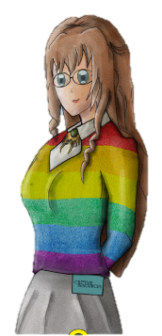
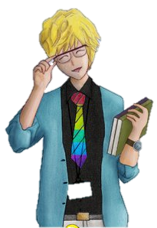





FOR MORE INFORMATION ABOUT THE TOPICS COVERED IN THIS UNIT WE WOULD ADVISE ONE OF THE BELOW: SPEAK TO YOUR PARENTS/GUARDIANS OR HEAD OF YEAR, TRUSTED ADULT OR FRIEND IF YOU HAVE ANY CONCERNS ABOUT YOURSELF OR SOMEONE YOU KNOW – IT IS ALWAYS IMPORTANT TO TELL SOMEONE! SUBMIT ANNONYMOUS QUESTION TO https://riseabove.org.uk/wall/
Enjoy the lesson, Challenge your perceptions and understand how to seek further advice and support
SPECIFIC FURTHER INFORMATION ON THIS TOPIC CAN BE FOUND HERE:
UK Safer Internet Centre: www.saferinternet.org.uk Professionals Online Safety Helpline: www.saferinternet.org.uk/helpline
Internet Watch Foundation: www.iwf.org.uk Childline: www.childline.org.uk | Phone: 0800 1111
Report abuse or grooming to CEOP: www.ceop.police.uk/ceop-report
2 Minutes
Notes:
TEACHER NOTES & IDEAS
Teachers should add in specific local signposting to charities, careers organisations / Connections or Careers officer at school. If RSE topics the local NHS services in their area
Add / adapt or remove any suggested sites.
Print this slide and leave on door notice board after the lesson

Slide 17


I know if I need further
support or help I could
speak to…. or contact…
Before I could/would say
and do ... but now I feel I
am able to say
Before I only knew ...
now I also know ...
I supported others by…
One thing I didn’t
realise was… now I know that…
The key words for
this lesson are…
I always knew ... but now
I can see how it connects to…
The most important thing I
have learnt today is…
I’m really proud of the
way I have…
I used to feel ...
but I now feel ..
One assumption of
mine that was
challenged was…
I would like to learn…
A question I
would like to
ask is…
Before I thought that ...
but now I realise..
Today I have tried to…
Next lesson I would like to..
Before I would have done…
Now I will …
Before I would have
said ... but now I will say…
2 Minutes
A problem I overcame
today was…
Notes:
TEACHER NOTES & IDEAS
: Have students pick either 1/2/3 tickets depending on their ability and tell a partner
Pick a few students at random to feedback to the class
As students leave the room have them tell you their reflection on the way out

Slide 18

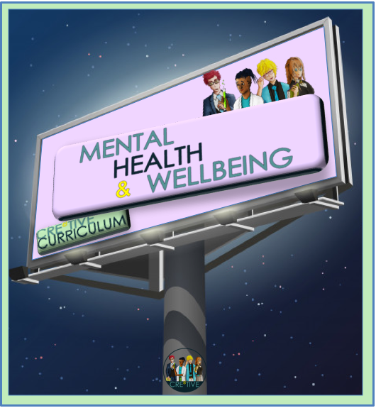




REFER TO MINDFULNESS POWERPOINT
Time for a little something extra?
?? Minutes
Notes:
TEACHER NOTES
Time for something extra?
Pick an activity or reflection question from the mindfulness and wellbeing PPT or add the activity you want on to the end of this PowerPoint before you start the lesson (or use as a starter)

